Slide 1

ML Capstone Project

Slide 2
Problem Statement
Dataset: Stroke Prediction Dataset
According to the World Health Organization (WHO) stroke is the 2nd leading cause of death globally, responsible for approximately 11% of total deaths.
Analyzing input parameters such as gender, age, whether they smoke or not and various diseases can help us predict whether a patient is likely to get stroke. Each row in the dataset provides information relating to this about the patient.
We have selected stroke prediction dataset to analyse various features involved in stroke with the data collected from various sources to predict stroke in patients and alerting the authorities if necessary.
Such a predictive model can help save lives of patients who suffer stroke as it can be predicted that was earlier not possible.

Slide 3
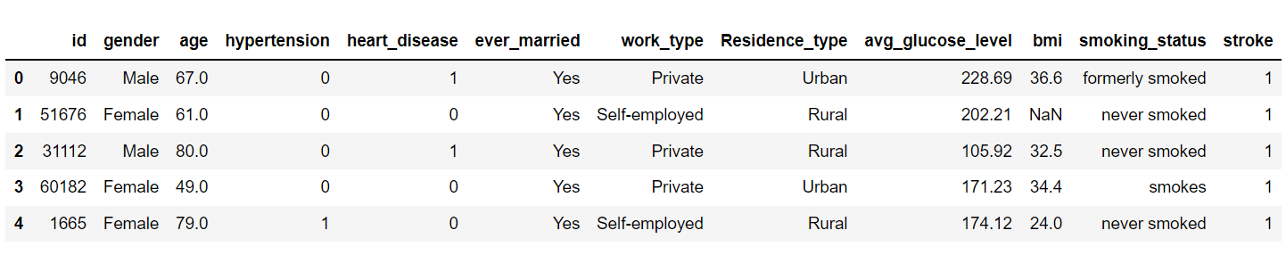
Understanding the Dataset
Attribute Information
id: unique identifier
gender: "Male", "Female" or "Other"
age: age of the patient
hypertension: 0 if the patient doesn't have hypertension, 1 if the patient has hypertension
heart_disease: 0 if the patient doesn't have any heart diseases, 1 if the patient has a heart disease
ever_married: "No" or "Yes"
work_type: "children", "Govt_job", "Never_worked", "Private" or "Self-employed"
Residence_type: "Rural" or "Urban"
avg_glucose_level: average glucose level in blood
bmi: body mass index
smoking_status: "formerly smoked", "never smoked", "smokes" or "Unknown"*
stroke: 1 if the patient had a stroke or 0 if not
*Note: "Unknown" in smoking_status means that the information is unavailable for this patient

Slide 4

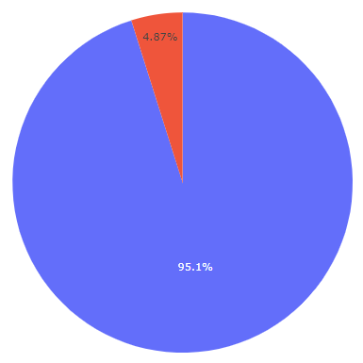
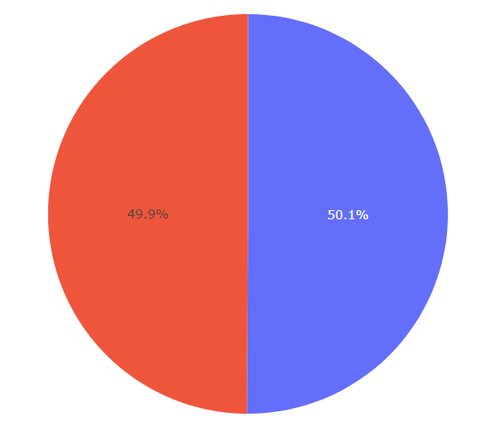
Exploratory Data Analysis (EDA)
Before After

Slide 5
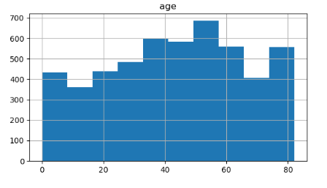
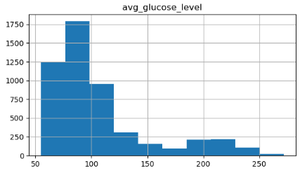
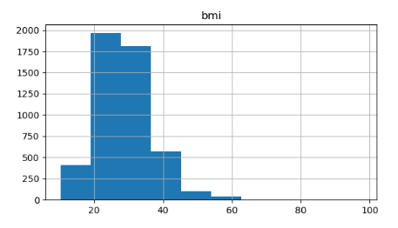
Exploratory Data Analysis (EDA) (contd.)
Numerical Distribution of Data

Slide 6
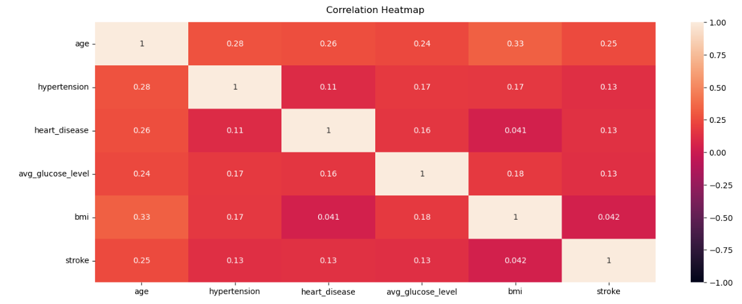
Data Preprocessing
Dropping Column “Id”
Using Iterative Imputer
Feature Correlation Heatmap

Slide 7

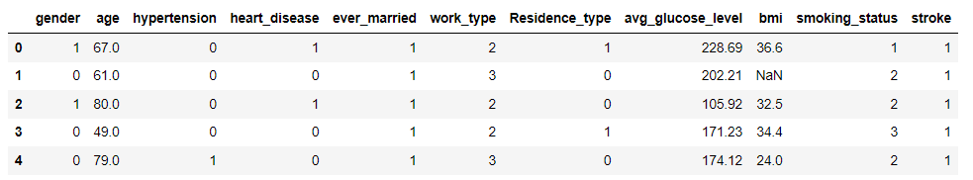
Data Preprocessing (contd.)
Label Encoder

Slide 8
Approaches used for Classification
Logistic Regression
K Neighbours Classifier
Decision Tree
Random Forest
SGD
SVM

Slide 9
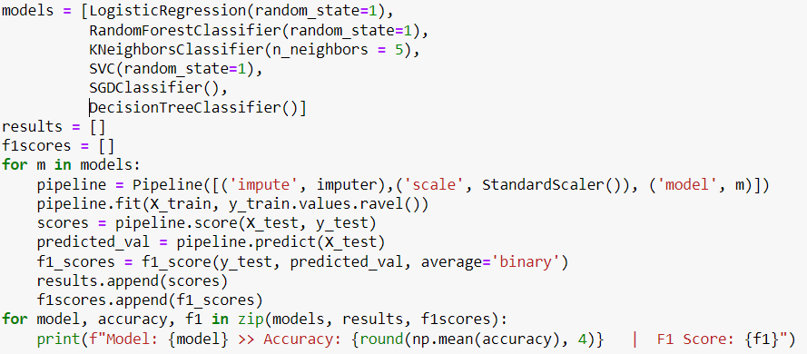
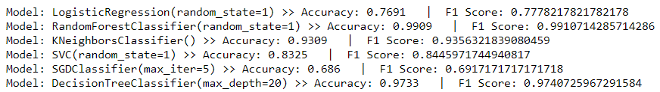
Approaches used for Classification (contd.)

Slide 10
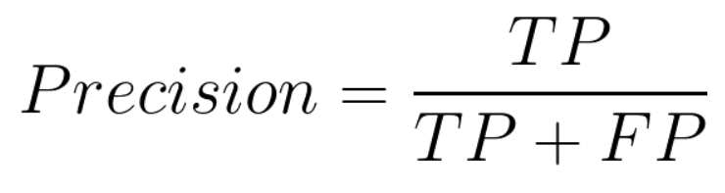
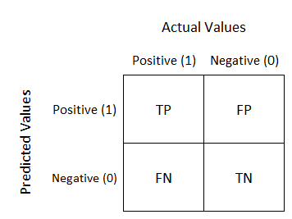
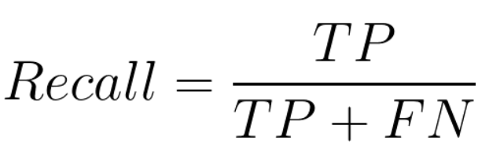
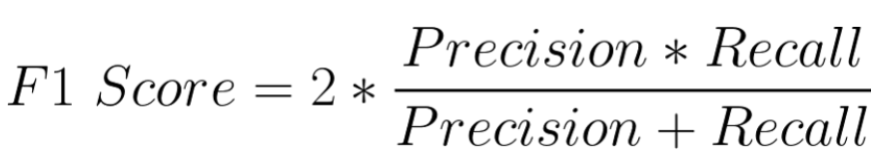
Methods for Evaluation Model Performance
Confusion Matrix
F1 Score

Slide 11

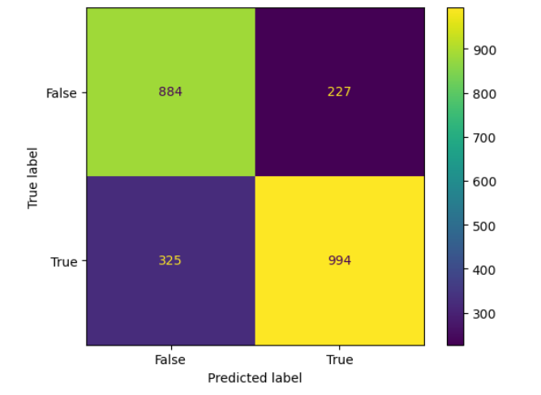
Logistic Regression
Dd
TP = 994
TN = 884
FP = 227
FN =325

Slide 12

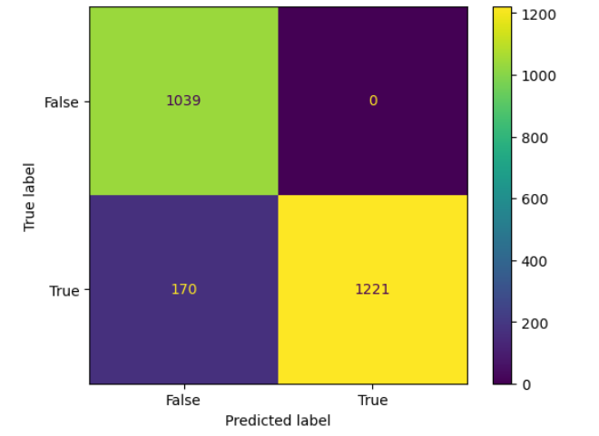
K Neighbours Classifier
Dd
TP = 1221
TN = 1039
FP = 0
FN =170

Slide 13

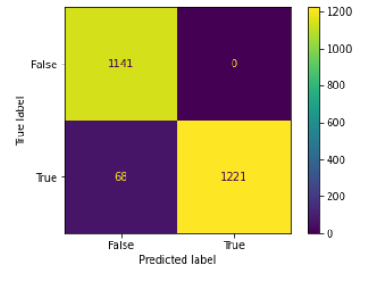
Decision Tree
a
TP = 1221
TN = 1141
FP = 0
FN =68

Slide 14

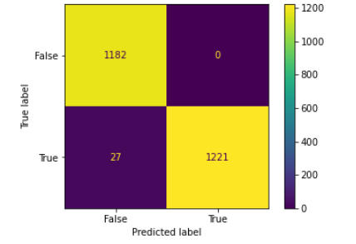
Random Forest
s
TP = 1221
TN = 1182
FP = 0
FN =27

Slide 15

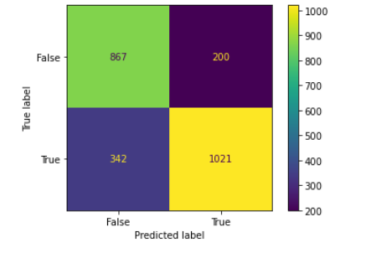
SGD
s
TP = 1021
TN = 867
FP = 200
FN =342

Slide 16

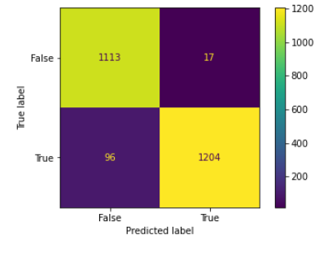
SVM
dd
TP = 1204
TN = 1113
FP = 17
FN =96

Slide 17
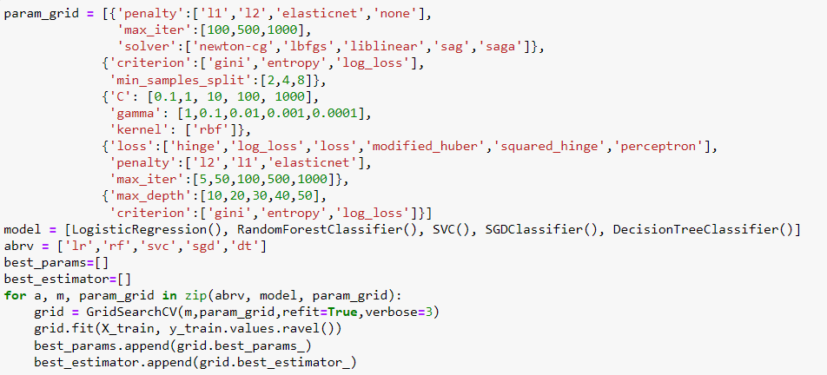
GridSearchCV for Hypertuning of Parameters
S

Slide 18
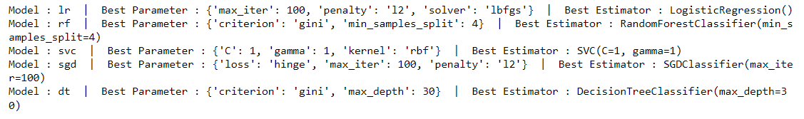
GridSearchCV for Hypertuning of Parameters (contd.)
The hypertuned parameters using GridSEarchCV are shown in the below snippet:

Slide 19
Observations
Based on the above experiments that we conducted as part of this Term Project; Random Forest is the best model for stroke prediction dataset with F1 score of 0.9890643985419197.

Slide 20
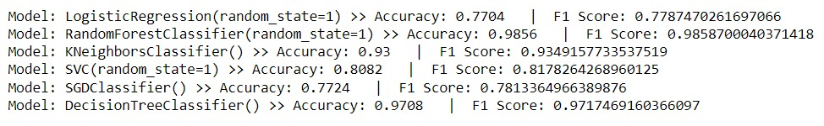
Re-evaluating Models (with removal of some features)
Removing BMI Feature since its seems that there is no clear numeric correlation between the stroke attribute and other numeric attributes in our dataset. Hence, we dropped BMI to see its effect on the data.
After removing BMI feature, we observe that the accuracy for SGDC improved from 68% to 77% whereas other models had minimal effect on accuracy.

Slide 21
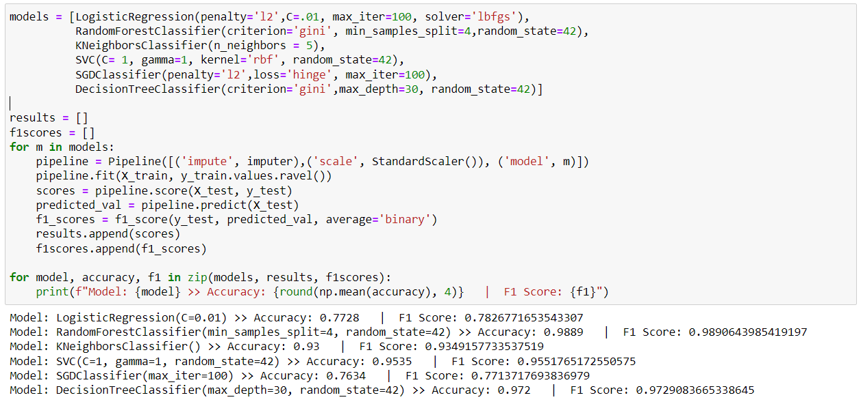
Model results based on tuned Hyperparamaters

Slide 22
Conclusion
After Exploratory data analysis, data preprocessing, applying classification approaches (building models) on the dataset we observed that Random Forest model is the best predictor for stroke target variable.
Using GridSearchCV and determining the best hyperparameters, we observed that all the models slight improvement in accuracies in which accuracy of SVC was improved the most from around 83% to 95% approx. Random Forest model was still the best overall model for the dataset.
The F1 Score of this model is 98.9%
The Accuracy of the model is 98.8%

Slide 23
References
Dataset: Stroke Prediction Dataset: https://www.kaggle.com/datasets/fedesoriano/stroke-prediction-dataset

